Slide 1
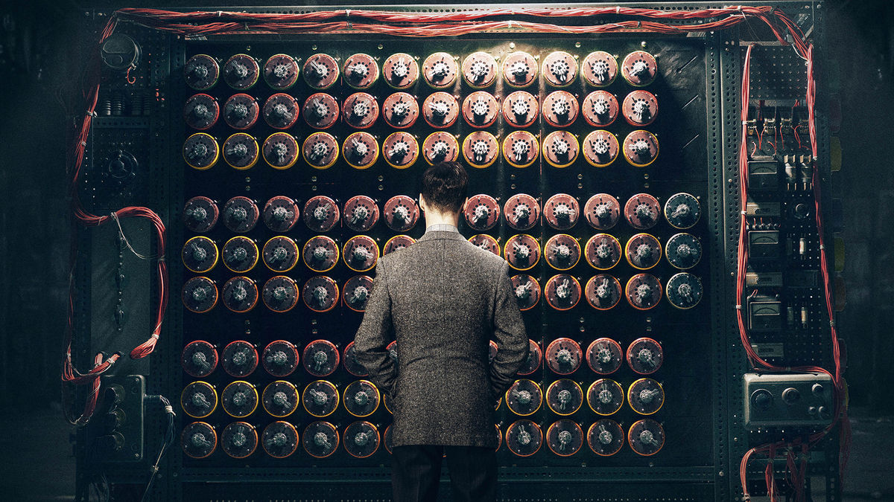

Slide 2
Simultaneous Attack
-Durgesh R.
Pranav S.
Tushar N.

Slide 3
The problem
Problem
Decryption Techniques used today generally work on single algorithm at a time, so the difficulty to guess the algorithm used in encryption is added task before moving any further.
Generally Decryption Techniques work on serial programming to maintain consistency of program output.

Slide 4
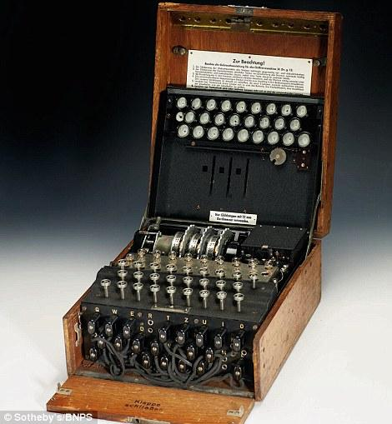
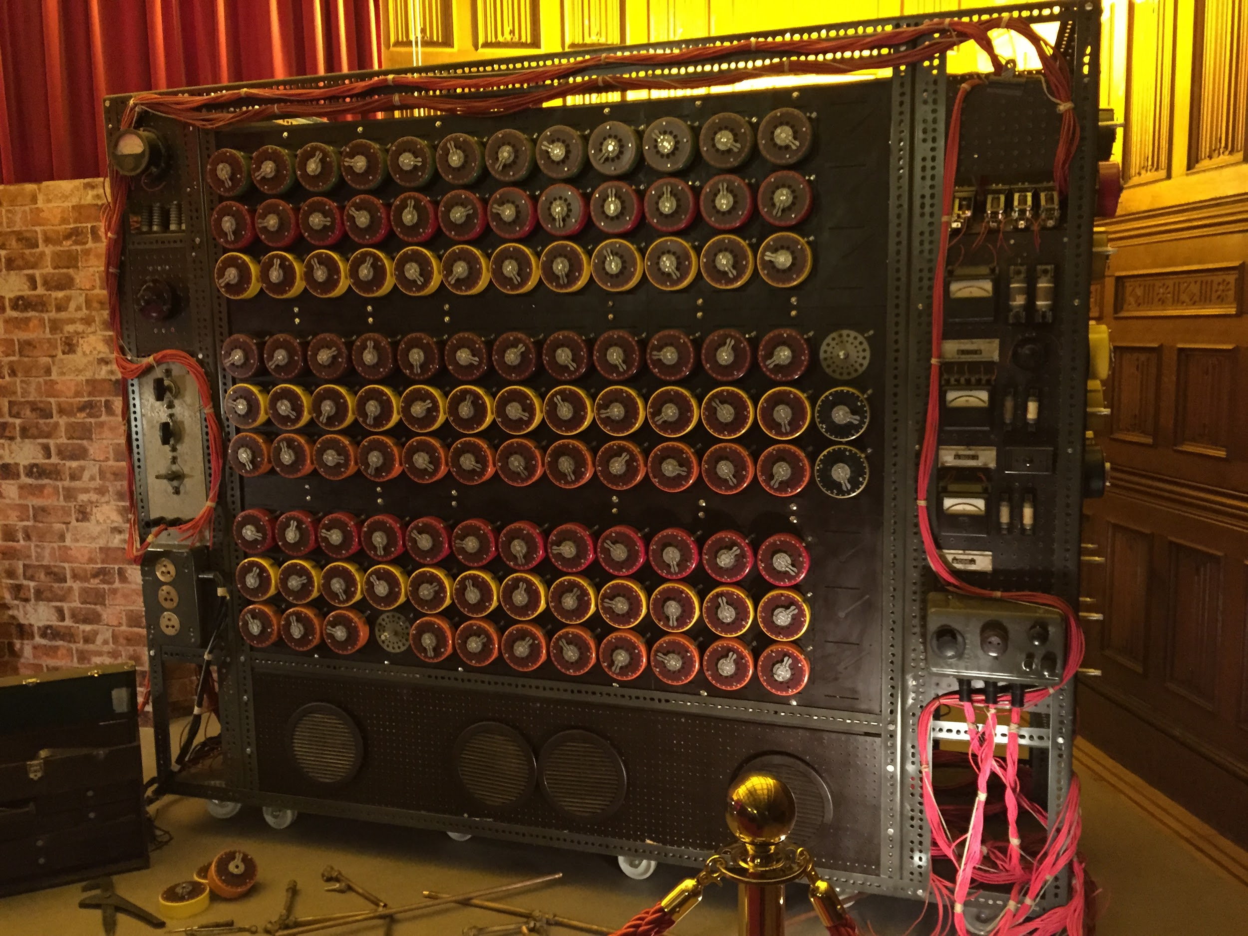
History
Enigma Machine
Various encryption techniques used by Germans during World War II.
British scientist Alan Turing prepared Turing Machine to break down German Enigma

Slide 5
Solution
To run multiple Decryption algorithms in parallel with every algorithm working in parallel by itself with a set of probable keys.

Slide 6
Challenges deep-dive
Challenge 1
Challenge 2
Challenge 3
Run multiple algorithms parallel
Used “sections” for parallelizing execution of multiple algorithms.
Make individual algorithms parallel
Used “omp for” for making algorithms in parallel.
Maintain consistency of program
Used “ordered” clause in some of the loops of algorithms.

Slide 7
Implementation

Slide 8
Working tree
Level 1
Main program
Algorithm 1
Algorithm 2
Caesar cipher
Poly alphabetic
Thread 1.1
Thread 1.2
Thread 1.3
Thread 2.1
Thread 2.2
Key 1
Key 2
Key 3
Key 1
Key 2

Slide 9
Impact
max growth
Serially program took 0.1sec
Parallely program took 0.02sec

Slide 10
THANK YOU !

